Slide 1


Charge-insensitive qubit design derived from the Cooper pair box (Section 3: Circuit QED for the Transmon)
Brant Norris*
Department of Electrical and Computer Engineering
Herbert Wertheim College of Engineering
University of Florida
*Email: brantnorris@ufl.edu

Slide 2
Outline
Introduction
Circuit QED for the Transmon
Hamiltonian Derivation
Coupling Strength
Control and Readout
Conclusion/Review
Progress Report: Jupyter Notebook Simple Quantum Simulator

Slide 3

Introduction
Section 1

Slide 4
Introduction
Embedding transmon in a superconducting transmission line resonator allows for control and readout of the qubit state.
This is known as circuit QED.
This can allow us to better understand and define the behavior of the transmon and its resonator.
The behavior can be described by a simple LC oscillator.

Slide 5
Circuit QED for the Transmon
Section 2

Slide 6
Hamiltonian Derivation
Section 2.1

Slide 7
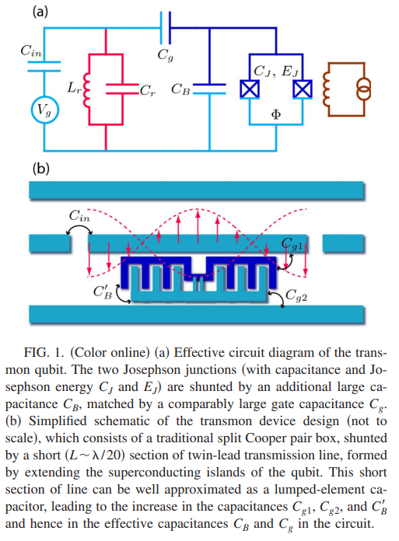
Hamiltonian Derivation
We can use the quantum-circuit Hamiltonian for a transmon attached to a superconducting transmission line as our starting point (seen in Figure 1 on the right).
With the Josephson junctions centered in the transmission line, the relevant resonator mode has the voltage antinode at the center of the resonator. This can be described by a simple LC oscillator.

Slide 8
Hamiltonian Derivation
With a large resonator capacitance C_{R} >> C_{Σ} (where C_{Σ} = C_{J} + C_{B} + C_{g}) the quantization of the circuit results in the following effective Hamiltonian:
Information on the detailed derivation of this Hamiltonian follows:

Slide 9
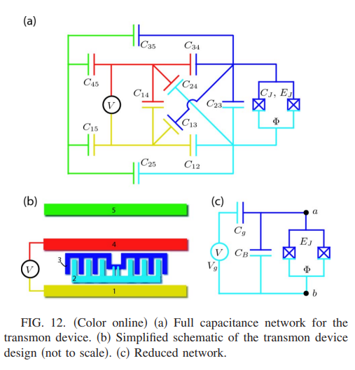
Hamiltonian Derivation
Hamiltonian:
In order to derive this Hamiltonian, we must start from an analysis of the full capacitance network. This network can be seen in the figure below.

Slide 10
Hamiltonian Derivation
In order to simplify this model, we take into account the two ground planes and center pin of the transmission line resonator as well as the two islands connected through the Josephson junctions.
Using Thevenin’s theorem, we can simplify any single-port linear network of impedance and voltage sources down to an equivalent circuit with a single voltage source and impedance.

Slide 11
Hamiltonian Derivation
In this case, this can be accomplished by allowing for one additional impedance, as shown in Figure 12 (c). The two effective capacitances can be interpreted as an effective gate capacitance and an effective shunting capacitance (C_{g} and C_{B} respectively). This adjusts for the correct voltage seen from the Josephson junction port via the parameter β=V_{ab}/V_{g}=C_{g}/C_{Σ} and the total capacitance between nodes a and b: C_{Σ} = C_{B} + C_{g} + C_{J}

Slide 12
Hamiltonian Derivation
The parameters β and C_{Σ} are extracted from the full capacitance network by associating each conducting island (enumerated by i=1, …, n) with a charge of Q_{i} and a potential of φ_{i}. These obey a linear relation: Q_{i} = Σ_{j} C_{ij} φ_{j.} For each island, we know either its charge or its potential (Uncertainty Principle), if we choose the island enumeration such that for islands i ≤ i₀ the charges are known, and for I > i₀ the potentials are known.

Slide 13
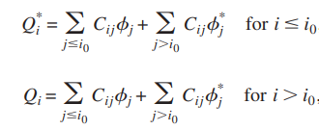
Hamiltonian Derivation
This gives us the following system of equations:
We can use this system of equations to determine the unknown quantities φ₁, ... , φ_{i0}, Q_{i0+1}, … , Q_{n}. With the solution, we can calculate the voltage at the a-b port by subtracting the corresponding island potentials. This gives us the splitting parameter β.

Slide 14
Hamiltonian Derivation
Next, we can obtain C_{Σ} by substituting the voltage source by a short and calculating the total charge energy of the network when applying a voltage V_{J} across the junction. Equating the result with C_{Σ} V²_{J} / 2, we can obtain C_{Σ.}

Slide 15
Hamiltonian Derivation
Completing this process for a transmon embedded in a transmission line resonator (as is the case in this paper, as shown in the figure on the right) is only slightly more complex. Using Thevenin’s theorem, we are able to simplify the capacitance network to a few effective capacitances.

Slide 16
Hamiltonian Derivation
This leads us from the complex circuit shown in Figure 12 below, back to the circuit shown in Figure 1 (a) on the right.

Slide 17
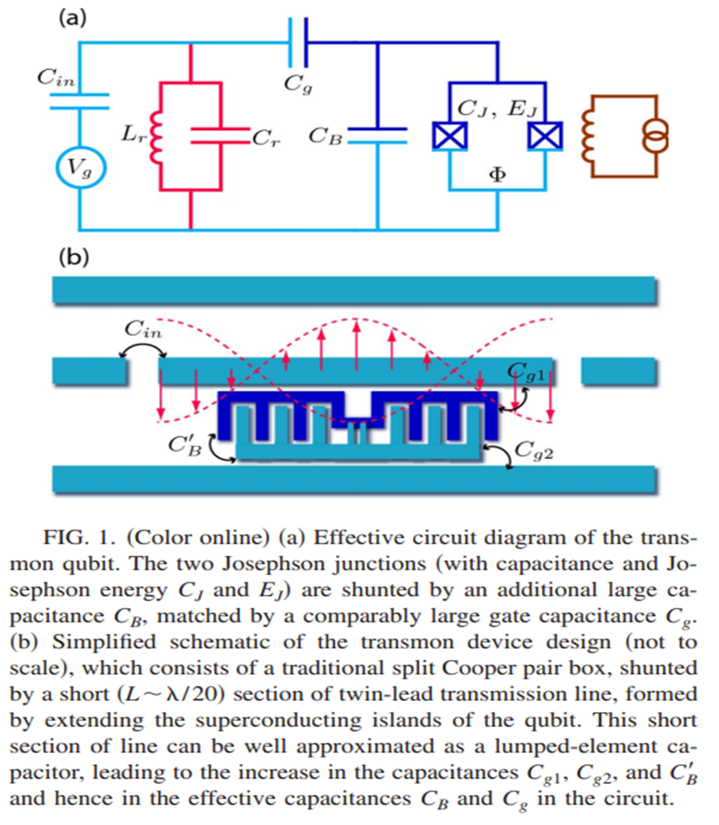
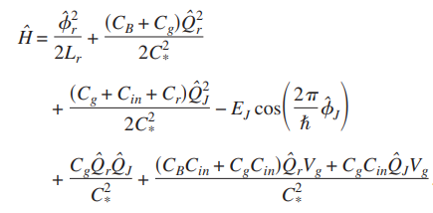
Hamiltonian Derivation
Now the effect of the resonator can be modeled by a simple local LC oscillator. Following the standard quantization procedure for circuits, we obtain:

Slide 18
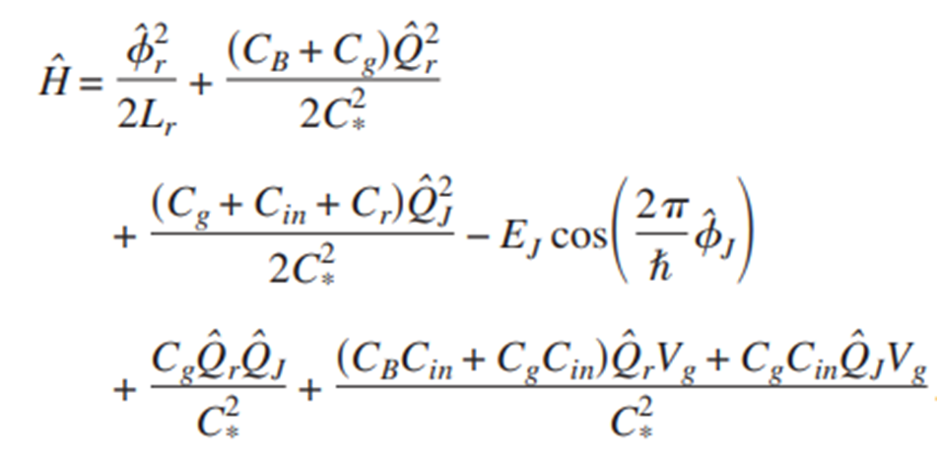
Hamiltonian Derivation
In order to simplify the Hamiltonian above, the junction capacitance have been absorbed into the parallel capacitance C_{B} and the abbreviation C*² = C_{B} C_{G} + C_{B} C_{in} + C_{g} C_{in} + C_{B} C_{r} + C_{g} C_{r}

Slide 19
Hamiltonian Derivation
The first two terms describe the local oscillator of the resonator, the two terms in the second line capture the qubit’s degrees of freedom, and the terms in the third line give the coupling between them as well as the coupling to the gate electrode.

Slide 20
Hamiltonian Derivation
Taking into account that
And assuming that C_{r} >> C_{B}, C_{in}, C_{g} we recover the Hamiltonian for the circuit:

Slide 21

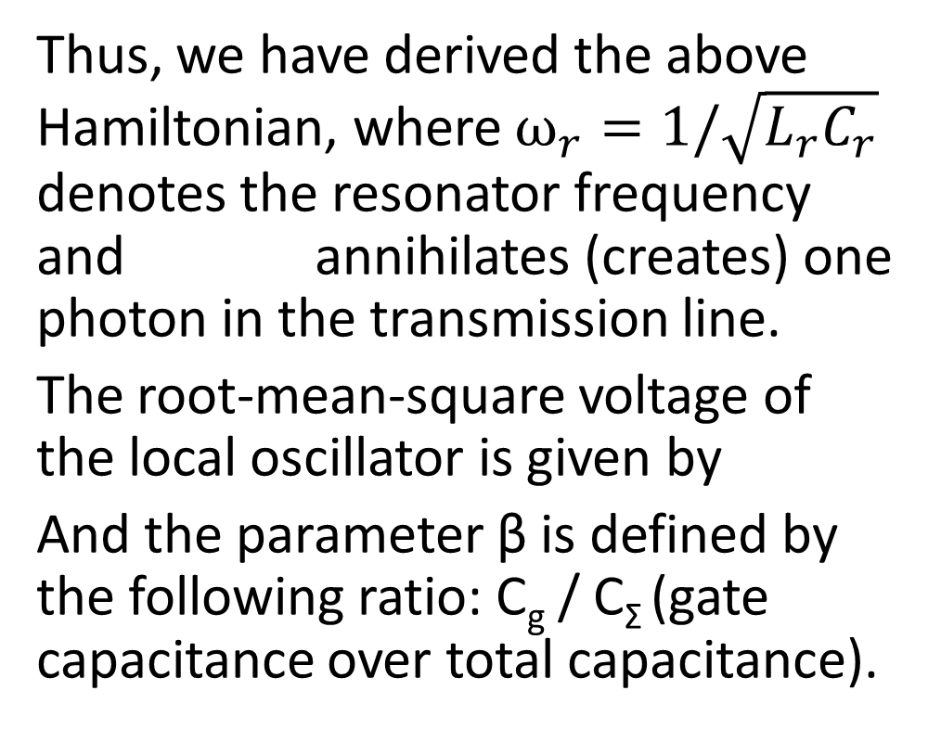
Hamiltonian Derivation
Thus, we have derived the above Hamiltonian, where $ω_{r}=1/\sqrt{L_{r}C_{r}}$ denotes the resonator frequency and annihilates (creates) one photon in the transmission line.
The root-mean-square voltage of the local oscillator is given by
And the parameter β is defined by the following ratio: C_{g} / C_{Σ} (gate capacitance over total capacitance).

Slide 22


Hamiltonian Derivation
Rewriting this Hamiltonian in the basis of the uncoupled transmon states |i>, one obtains the generalized Jaynes-Cummings Hamiltonian:
With coupling energies of:

Slide 23
Coupling Strength
Section 2.2

Slide 24
Coupling Strength
Despite the exponentially decreasing charge dispersion for a large energy ratio (E_{J}/E_{C}), the coupling between cavity and transmon (expressed by the coupling energies hg_{ij}) does not become small but actually increases. This is a central point expressed throughout this paper and is crucial for the practicality of utilizing transmon systems as actual qubits.
The couplings g_{ij} are determined by a prefactor containing the capacitance ratio β, the rms voltage of the local oscillator V⁰_{rms} and by a matrix element of the number operator for Cooper pairs which depend on the energy ratio E_{J}/E_{C}. It is interesting to note that there is a fundamental upper bound to the magnitude of the prefactor.

Slide 25

Coupling Strength
There is a fundamental upper bound to the magnitude of the prefactor. This can be seen in the following expression:
Where the relation (valid for a half-wave transmission line resonator), and (denoting the fine structure constant) are used.

Slide 26
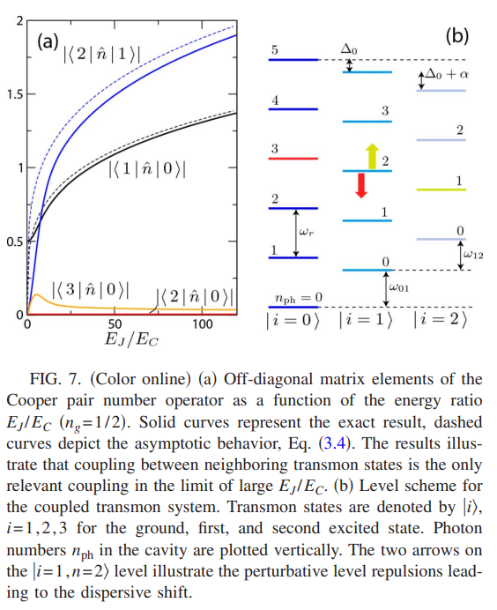
Coupling Strength
While the magnitude of the prefactor is limited, the relevant matrix elements between neighboring transmon states exhibit an approximate power law increase as a function of E_{J}/E_{C} as depicted in Fig 7 (seen on the right). The parameters β and E_{J} / E_{C} cn be tuned separately, as β is essentially determined by the device’s geometry whereas E_{J}/E_{C} can be tuned by an external magnetic flux.

Slide 27
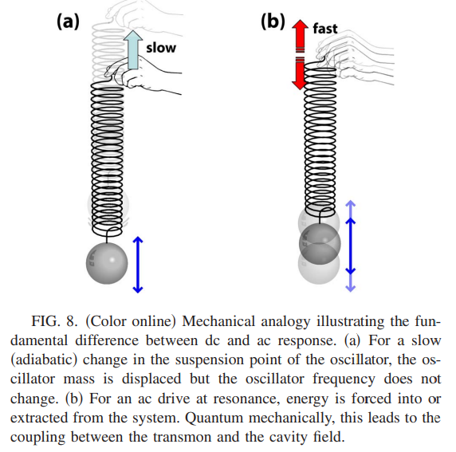
Coupling Strength
This means that the charge dispersion and the magnitude of the ac coupling are completely disparate. The fundamental difference between dc and ac response is illustrated in Figure 8 on the right. For large E_{J}/E_{C} the transmon can be interpreted as a harmonic oscillator in the charge basis, with its quadratic potential centered at n = n_{g}.

Slide 28
Control and Readout
Section 2.3

Slide 29
Control and Readout
In the dispersive limit, the detunings between the transmon and the cavity are large. Thus, using a canonical transformation, we can eliminate the cavity-qubit interaction to lowest order. The steps of this canonical transformation follow.

Slide 30
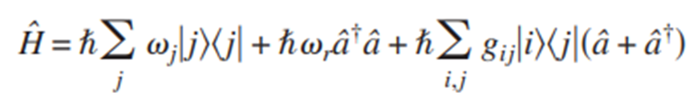




Control and Readout
The elimination of the interaction term in the Jaynes-Cumming Hamiltonian:
can be accomplished by a canonical transformation
Writing the unitary operator in the form
The appropriate generator for the lowest three qubit states is given by
Here, the parameters β_{i} are defined as

Slide 31
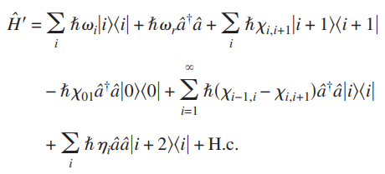


Control and Readout
Employing the Baker-Campbell-Hausdorff relation (the solution Z to
e^{X} e^{Y} = e^{Z}), we obtain a transformed Hamiltonian:
with and

Slide 32




Control and Readout
Using the coupling energy equation
the dispersive frequency shifts between neighboring transmon states can be written as
Combining this equation with
We obtain the following asymptotic expression for the dispersive frequency shift, valid for E_{J}/E_{C} >> 1.

Slide 33

Control and Readout
Thus, after this we can restrict the transmon Hilbert space to the ground state and first excited state, due to anharmonicity. This leads to the following Hamiltonian:

Slide 34
Conclusion/Review
Section 3

Slide 35
Conclusion/Review
Thevenin's theorem can be used to reduce the complex transmon circuit to a simpler circuit with significantly fewer effective capacitances. This allows us to derive the Hamiltonian of the transmon.
Despite the exponentially decreasing charge dispersion for a large energy ratio (E_{J}/E_{C}), the coupling between cavity and transmon (expressed by the coupling energies hg_{ij}) does not become small but actually increases.
Embedding transmon in a superconducting transmission line resonator allows for control and readout of the qubit state.

Slide 36
Progress Report: Jupyter Notebook Simple Quantum Simulator
Section 4

Slide 37
Progress Report: Simple Quantum Sim
I wanted to sharpen my skills with quantum, visual, object-oriented, and front-end Python libraries (Qiskit, QuTiP, matplotlib, ipywidgets, and IPython) as well as start some potential progress toward a foundation for our quantum simulator.
In order to achieve this, I created a very basic quantum simulator with a simple front-end for inputs. I created this as a Jupyter Notebook application.

Slide 38
Progress Report: Simple Quantum Sim
For now, the simulator just supports ideal single-qubit gate operations and only allows for two inputs: an initial state and a gate operation type. However, this will be easy to expand upon to create more complex circuits and operations in the future. This was primarily intended to sharpen my own personal skills and give our team a very basic foundation upon which to build in the coming months.

Slide 39
Progress Report: Simple Quantum Sim
After inputting an initial state and a gate type, the simulator will draw the corresponding circuit, and display a histogram showing the probabilities of the state of the qubit after the gate operation.

Slide 40
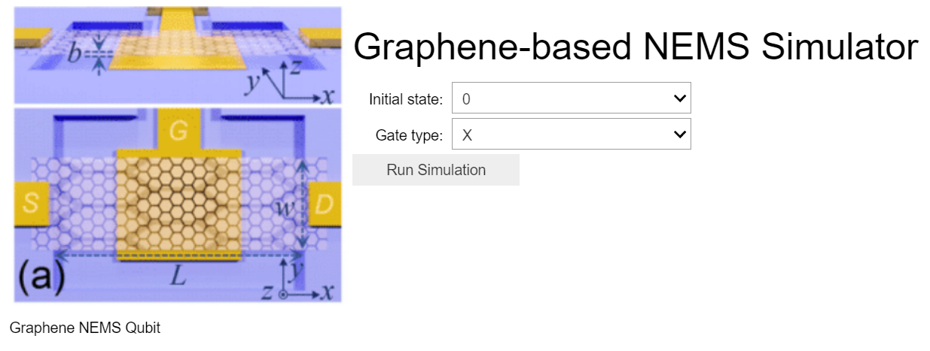
Progress Report: Simple Quantum Sim

Slide 41
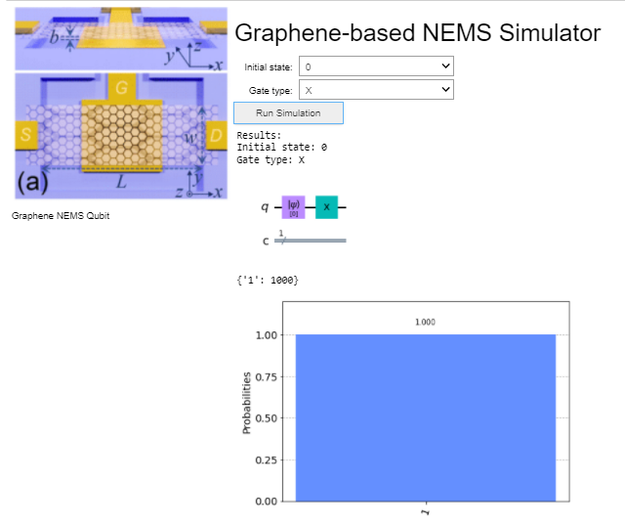
Progress Report: Simple Quantum Sim

Slide 42
Thanks!

